Slide 1
Aberdeen was accepted as a Dementia Friendly America community on September 17, 2019 – the first in South Dakota

Slide 2
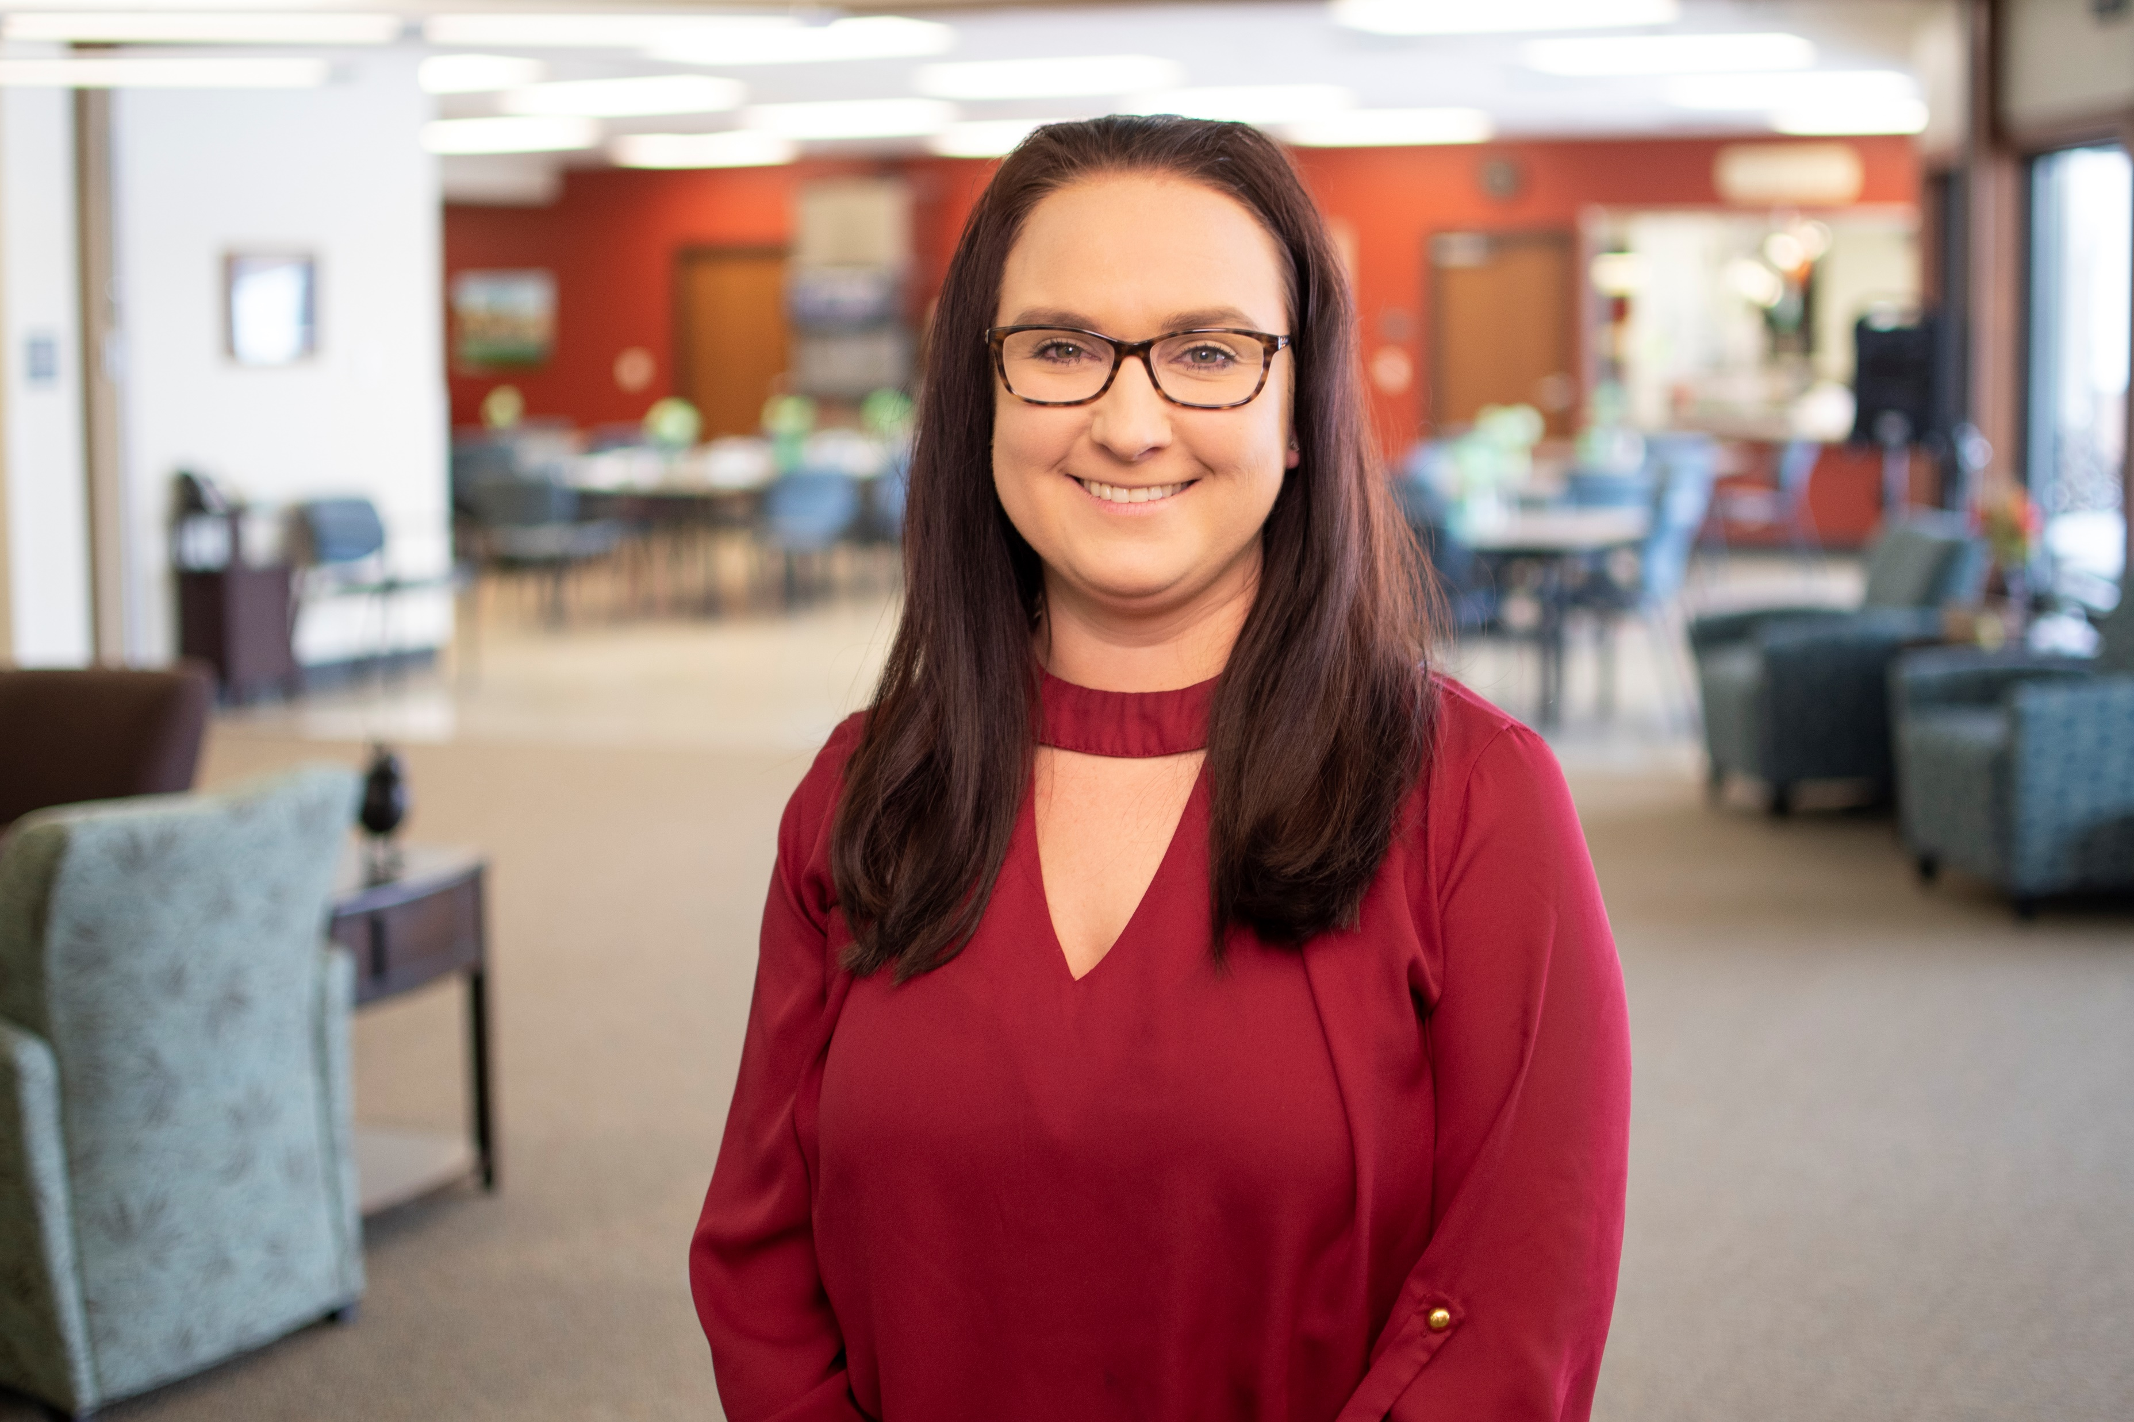
Charity Pionk, CDS, CDP
Director, Adult Day Health Center at Bethesda
Jessica Rehder, CDP
Sales Director, Primrose Retirement Communities

Slide 3
What It Is
Founded in 2015, DFA is a national network of communities, organizations, and individuals who are equipped to support people living with dementia and their caregivers
Coordinate dementia care facilities and relevant professionals with a goal of remaining in the home longer
Support services for caregivers
Awareness
Community education
Communication

Slide 4
What It Is Not
It is not exclusive to any business or organization
It is not selectively promoting any discipline dedicated to high quality dementia care
It is not stand-alone
It is not static; it will evolve over time
It is not competitive with other essential organizations like the Alzheimer’s Association; instead, it works in collaboration

Slide 5
Why It Exists
More support to caregivers
Higher quality of life for dementia patients
Opportunity for further education
Greater access to support resources
Being proactive regarding expenditures for medical care in the upcoming dementia epidemic

Slide 6
How It Works
Provides education and socialization opportunities for caregivers and patients; e.g.: Memory Café
Offers education to businesses for better communication – servers, clerks, tellers, etc.; e.g.: Purple Menu
Educates first responders (EMS, police, fire, etc.)
Educates direct care providers in clinics, hospitals, extended care facilities, etc.

Slide 7
Caring for a loved one with Dementia… Jim & Kathi Herman

Slide 8
A 10-question survey was available online to individuals in the Aberdeen community. Our goal was to receive 100 responses.
Total Response Received = 196

Slide 9
Answer Choices Response
Strongly Agree 58.46% 114
Agree 40.00% 78
Neither Agree/Disagree 1.54% 3
Disagree 0.0% 0
Strongly Disagree 0.0% 0
Answer Choices Response
Strongly Agree 15.46% 30
Agree 30.93% 60
Neither Agree/Disagree 34.02% 66
Disagree 15.98% 31
Strongly Disagree 3.09% 6

Slide 10
What’s our Goal…
Door to Door Services for safety of the elderly, disabled, and children
Educate the community on how to interact with those with Dementia
Look for Signs/Symptoms
CARES Approach
Develop new friendships throughout the community
Develop new resources throughout your community
Declare Dementia Friendly America Day January 22nd every year in South Dakota!

Slide 11
How to use the CARES Approach….

Slide 12
What’s in it for you…
Understanding that Dementia is more than just a Diagnosis
Having increased knowledge of recognizing dementia signs/symptoms
Ensure a safe and enjoyable trip for all riders
Increased Riders = Increased Revenue
New relationships throughout the community

